Slide 1
Picking Politicians’ Sides
Predicting political affiliation from tweets
Paul

Slide 2
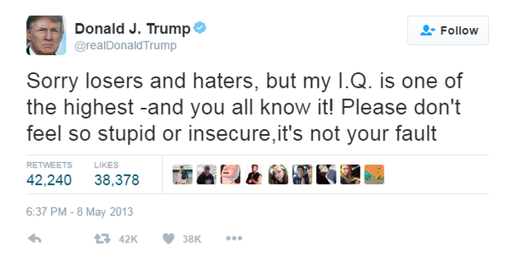
The Goal
The aim is to predict the political orientation of a twitter user from one of their tweets
The ability to predict political orientation of Twitter users has high and potentially widespread application
22% of American adults have used social networks for a political purpose
wow

Slide 3

Initial thoughts
Raw tweets are unsuitable as features for classification algorithms
My hypothesis is that democratic and republican politicians talk about different topics in their tweets
For the topics that they both discuss they may express different sentiments about it
bark bark

Slide 4
Dataset
Originally from Kaggle, but it was incomplete
The tweets in the dataset did not contain the full text of the original tweets
However, it did contain the twitter handles of 210 democratic representatives and 226 republican representatives
I wanted to use tweepy to get the 200 most recent tweets from these 436 politicians
However, some accounts used were no longer active, and some did not have 200 tweets
Final dataset has 66,572 tweets from 412 politicians

Slide 5
Data Preprocessing
Raw utf-8 encoded tweets are quite messy

Slide 6
Data Preprocessing
Raw utf-8 encoded tweets are quite messy

Slide 7
Data Preprocessing
Raw utf-8 encoded tweets are quite messy

Slide 8
Data Preprocessing
Raw utf-8 encoded tweets are quite messy

Slide 9
Data Preprocessing
Raw utf-8 encoded tweets are quite messy

Slide 10
Data Preprocessing
Raw utf-8 encoded tweets are quite messy
Many tweets have emojis, special characters, and/or typos
14% of tweets had non-real words after cleaning

Slide 11

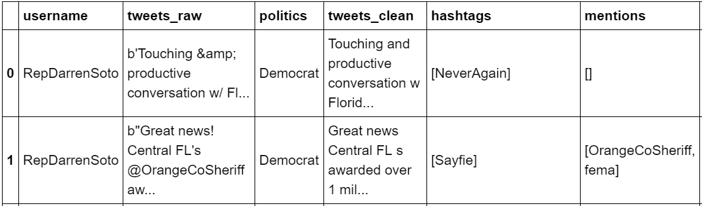
Feature Extraction
Hashtags and mentions were retrieved and stored

Slide 12
Feature Extraction
Hashtags and mentions were retrieved and stored
TextBlob was used for sentiment analysis

Slide 13
Feature Extraction
Hashtags and mentions were retrieved and stored
TextBlob was used for sentiment analysis

Slide 14
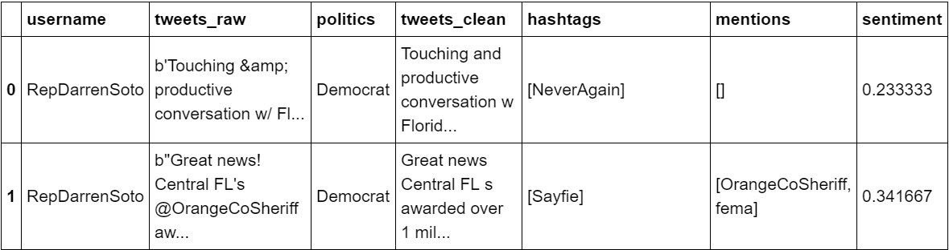
Feature Extraction
Hashtags and mentions were retrieved and stored
TextBlob was used for sentiment analysis

Slide 15
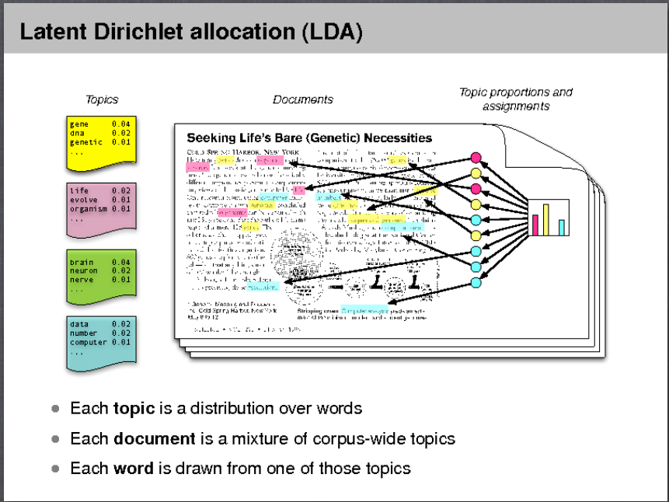
LDA
Performing LDA on raw tweets has been shown to be inefficient
However, some success has been had in aggregating tweets for performing LDA*
I trained 3 LDA models
One on the whole corpus (15 topics)
One on republican tweets (10 topics)
One on democratic tweets (10 topics)
* https://snap.stanford.edu/soma2010/papers/soma2010_12.pdf

Slide 16
LDA Example
* https://snap.stanford.edu/soma2010/papers/soma2010_12.pdf

Slide 17
Feature Engineering
An LDA model, given a text, will return a probability distribution over topics
Constructed a sparse matrix out of topics

Slide 18
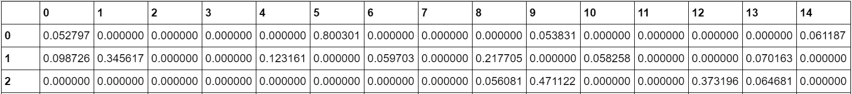
Feature Engineering
An LDA model, given a text, will return a probability distribution over topics
Constructed a sparse matrix out of topics

Slide 19
Feature Engineering
An LDA model, given a text, will return a probability distribution over topics
Constructed a sparse matrix out of topics
Topics

Slide 20
Feature Engineering
An LDA model, given a text, will return a probability distribution over topics
Constructed a sparse matrix out of topics
Topics
Tweets

Slide 21
Feature Engineering
I wanted to see if sentiment combined with topics would be valuable
Therefore I would run each model with and without multiplying their value by the sentiment

Slide 22

Initial Results

Slide 23
Initial Results
 | Single LDA | Single LDA + sentiment | Double LDA | Double LDA + sentiment
Accuracy | 57.2% | 54.7% | 50.4% | 54.3%

Slide 24
Further Attempts
Had not used the valuable resource of hashtags or mentions
*Paper had success using mentions to predict political affiliation
* http://cnets.indiana.edu/wp-content/uploads/conover_prediction_socialcom_pdfexpress_ok_version.pdf

Slide 25
Further Feature Engineering
Question is how to feed mentions in as a feature
Just use another sparse matrix
However, there were 12,054 different users mentioned in the tweets

Slide 26
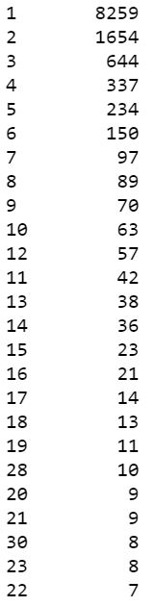
Further Feature Engineering
Number of mentions in corpus
Number of mentions in corpus
Question is how to feed mentions in as a feature
Just use another sparse matrix
However, there were 12,054 different users mentioned in the tweets

Slide 27
Further Feature engineering
I dropped twitter accounts which had been mentioned less than 30 times
Left 137 remaining
I, again, wanted to see if sentiment is a useful feature in combination with mentions

Slide 28
Second Round of Results

Slide 29

Future Work
Bigger Dataset
More politicians, not necessarily more tweets
Instead of testing individual tweets I should be testing tweets aggregated by politician
Better text cleaning
Better way of inputting topics/mentions
Authors mentioned earlier used co-occurrence mentions
Future,
the rapper

Slide 30
Thanks
thanks
thanks

